Slide 1
An introduction to the resources available to members of Wilkie Way
The directory gives you the heading and I have showcased just a few areas – there is more and more resources are continually being added
Keep up to date with notifications of new resources by following Wilkie Way on Facebook
https://www.facebook.com/wilkiewaynumeracy/

Slide 2
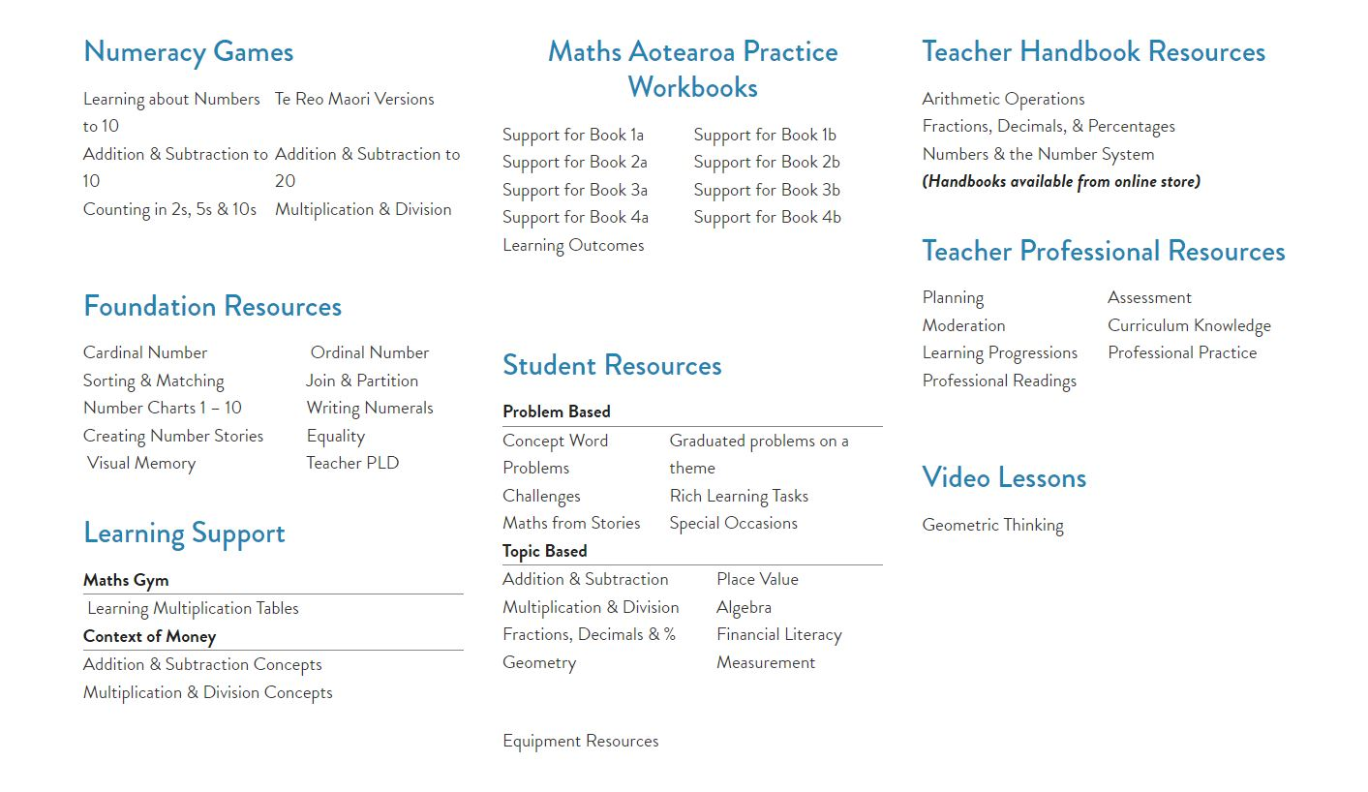
To access resources click on the link which will take you to the dropbox database which opens in a new window so you can always quickly get back to the directory.

Slide 3
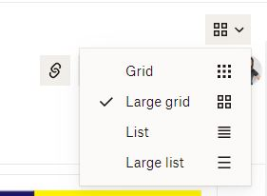
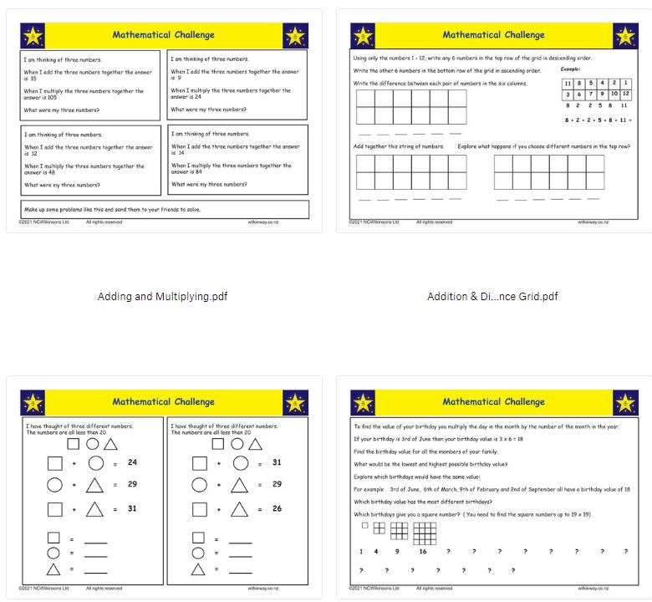
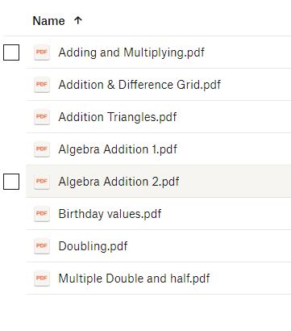
Some links take you direct to the downloadable files
Toggle between list and grid to see files

Slide 4
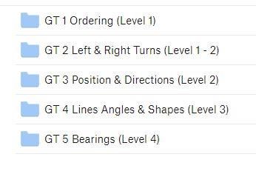
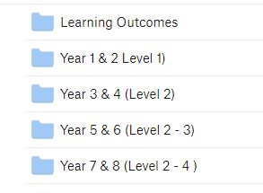
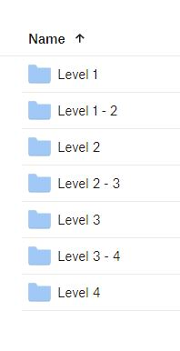
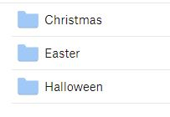
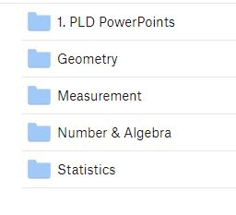
Some links take you to folders to open to reach the downloadable files

Slide 5
Finding resources
Resources may appear in multiple places on the website:
E.g. Addition and Subtraction Level 1 has the games from the Early Numeracy Games section and word problems from the Concept Word Problem link and number sentences from the Foundation Resources section plus resources not in any other section.

Slide 6
Maths Aotearoa Workbooks
Support for:
Book 1a (workbooks 1 - 12)
Book 1b(workbooks 12 - 24)
Book 2a(workbooks 1 - 13)
Book 2b(workbooks 14 - 26)
Book 3a (workbooks 1 – 8)
Book 3b (workbooks 9 – 16)
Book 4a (workbooks 1 – 6)
Book 4b (workbooks 7 – 11)
Each workbook contains 7 pages of practice activities on the specific area. The booklets provide further practice for activities found in Maths Aotearoa chapters (Formally Pearson Mathematics) Use print booklet function on your photocopier to create the workbook.

Slide 7
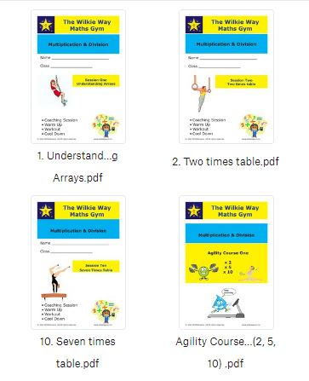
Use print booklet function on the photocopier.
Learning Support
Maths Gym
Learning Multiplication Tables
Understanding arrays
Two times table
Ten times table
Five times table
Exploring division
5a. Agility Course 1
Doubling x4 x 8
Three times table
Nine times table
Doubling x6 x12
Seven times table
10a. Agility Course 2
The coaching session in each workbooks will also assist teachers to focus on the algebra (patterns and relationships) when teaching basic facts
Intended for older students (year 5 and above) to assist the development of multiplicative thinking as well as recall multiplication facts.

Slide 8
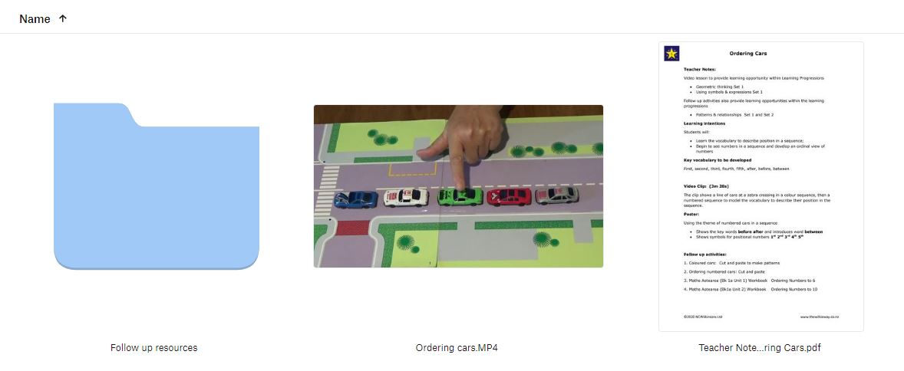
Video Lessons
Geometric Thinking
This section currently contains five folders one for each of the first five progressions in geometric thinking covering curriculum levels 1 – 4+
Each folder contains:
Teacher notes
A video lesson
Follow up work – activities and worksheets

Slide 9
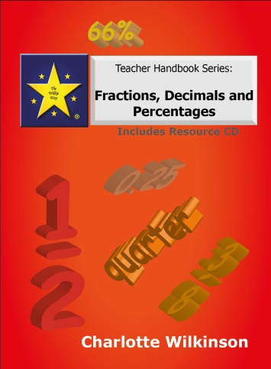
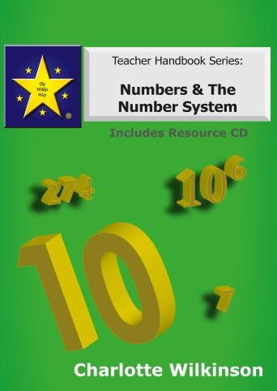
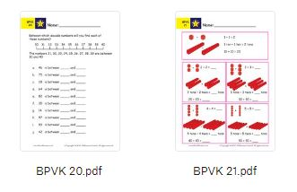
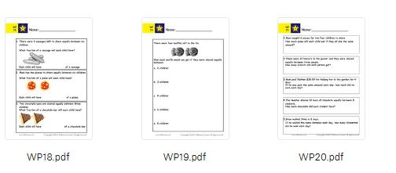
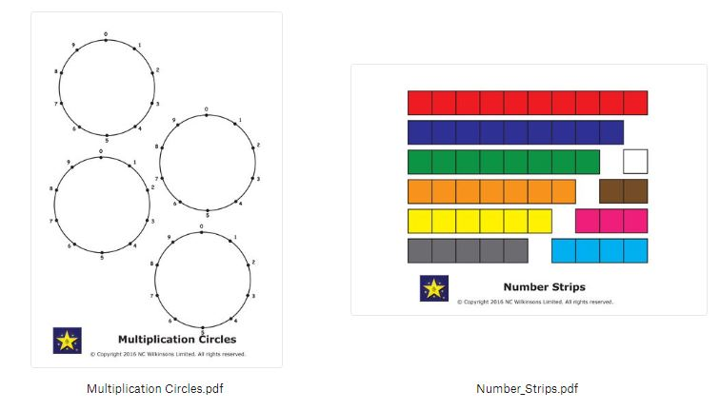
Teacher Handbook Resources
Arithmetic Operations
Fractions, Decimals, & Percentages
Numbers & the Number System
(Handbooks available from online store
$50 each or all three $135)
Folders contain all the worksheets found on the CD’s included in the Fractions Decimals & Percentages book and the Numbers & The Number System book.
Also contains all resources referred to in the activities given in the Arithmetic Operations book.
Numbers & The Number System
Knowledge Building 110 worksheets
Word Problems 20 worksheets
Fractions Decimals & Percentages
Knowledge building 81 worksheets
Word problems 60 worksheets

Slide 10
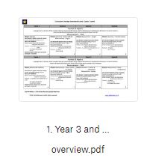
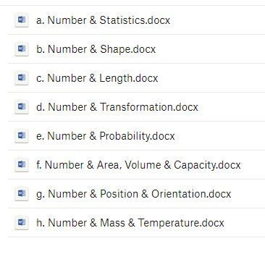
Wilkie Way helps you to plan your programme, build your knowledge and track your students progress.
Directory heading: Planning
Specific to year group but also found under curriculum knowledge heading
Specific to year group but also found under assessment heading
Overview and unit plans in word to be adjusted to suit specific requirements and resources to be added.

Slide 11
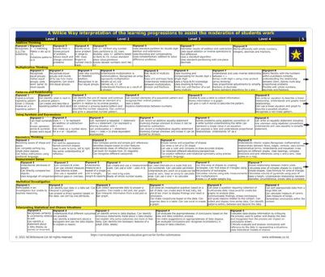
Teacher Professional Resources
Learning Progressions
Progressions for:
Addition & Subtraction
Multiplication & Division
Fractions
Place Value
Number operations – how the four progressions above are interlinked
Geometry progression
Measurement progression
Learning progression
How all the progressions are interlinked including statistics.
Progressions will be updated and aligned to fit with the wording of the new mathematics and statistics curriculum over 2023

Slide 12
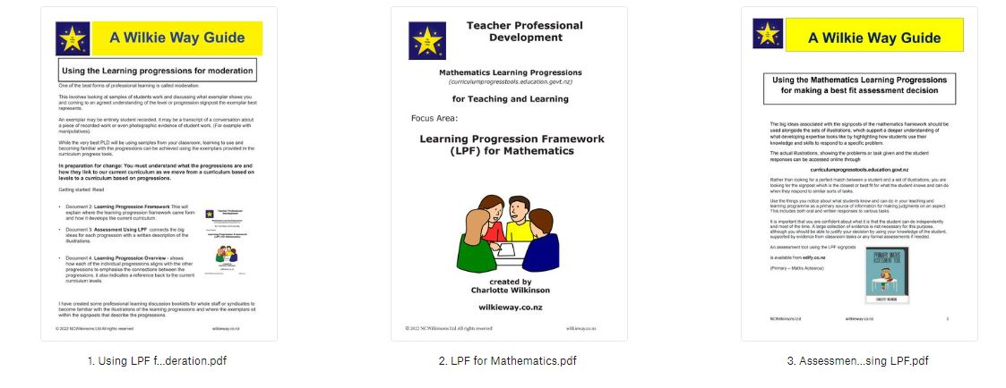
Teacher Professional Resources
Moderation
In this sections you will find booklets to help you develop your understanding of the learning progressions using the exemplars to make assessment decisions. Learning to understand student work enables you to make use of formative assessment as you work with the students and a summative decision is reliable.

Slide 13
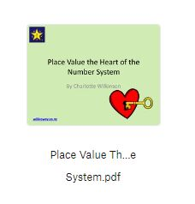
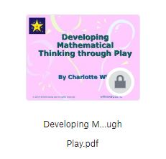
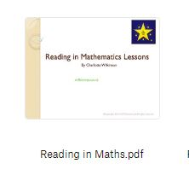
Teacher Professional Resources
Professional Practice
Professional Readings
PowerPoints for increasing teacher knowledge – use independently or for a staff or syndicate profession learning session.
Able mathematicians
Arrangement for learning
Building maths knowledge
Common stumbling blocks
An introduction to developing maths through play
Developing mathematical thinking through play
Planning for maths in a playbased environment
Fractions & learning progressions
Number & measurement connections
Place value, the heart of the system
Reading in maths
Writing in maths
Speaking & listening in maths
Statistic – getting sorted
Parent information
Reviewing your numeracy curriculum
Supporting numeracy learners
Teaching & learning basic facts
New PowerPoints are added regularly and all additions to the website are notified via the newsletter and on Facebook.
https://www.facebook.com/wilkiewaynumeracy/

