Slide 1
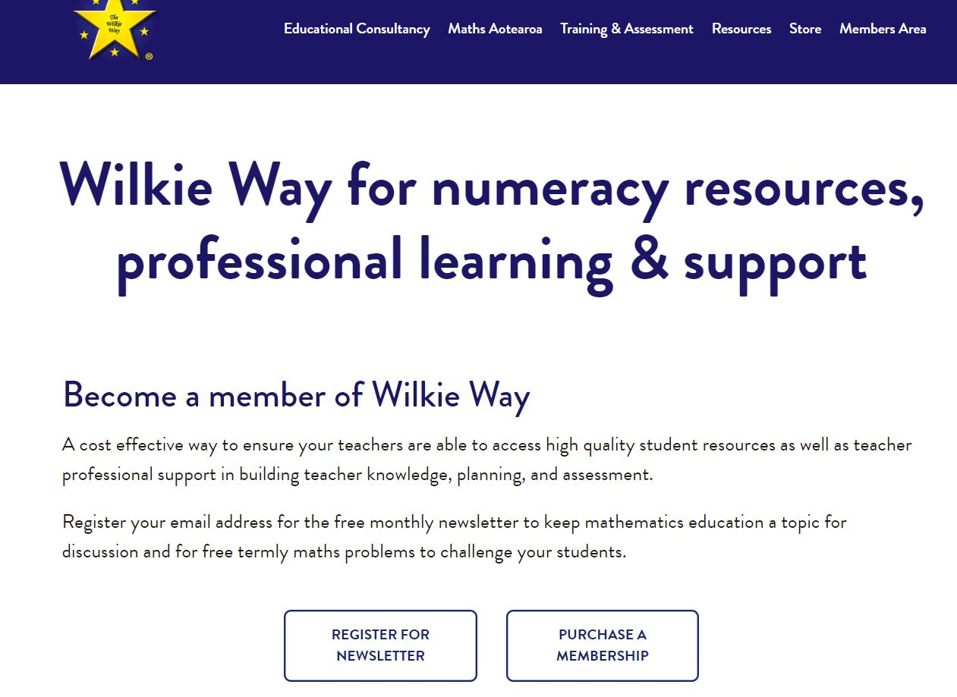
Start here.

Slide 2
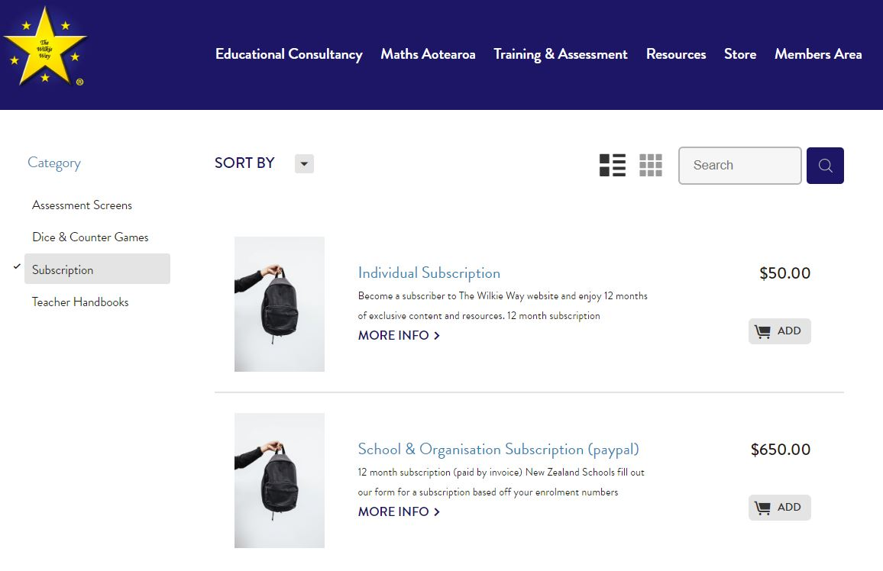
NZ Schools Only
Under 30 students $50 + GST
30 – 100 students $150 + GST
101 – 300 students $250 + GST
301 – 500 students $350 + GST
501 – 700 students $450 + GST
701+ students $550 + GST
New Zealand School membership click MORE INFO to subscribe via a school invoice

Slide 3
Create an account (or I will create one for you and send you a password when I see you have purchased a membership)
If you create an account it must be activated by the administrator before you can log in (This may take a couple of hours depending of whether I am at the computer or not – guaranteed within 12 hours.)

Slide 4
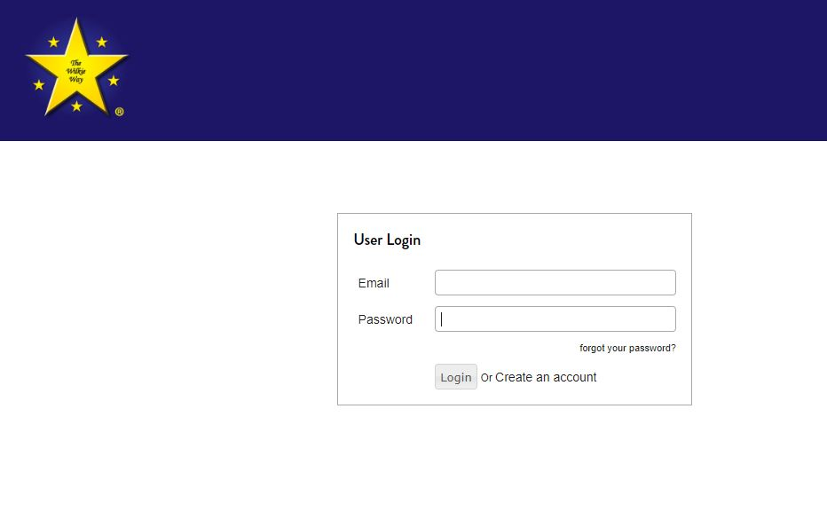
Please ensure you type your email address correctly.
IMPORTANT
School subscriptions:
Each individual teacher must create an account using their school email address. Each account will then be activated by the administrator (Me)
Alternatively a list of email addresses can be sent to me and I will create the accounts and send a unique password to each teacher.
Click here to create an account.

Slide 5
Once your account has been activated (you will receive an email to let you know so make sure you typed it properly)
You can then login using the email address you signed up with and your unique password.
Your subscription is valid for 12 months and an individual will receive an email reminding you to renew by purchasing a new subscription. An account will be suspended if not renewed within one month of expiry and deleted after one month.
Schools will receive an invoice a month before the subscription is due. If invoice is not paid by 20th of month following then all accounts will be suspended. An email will advise you if this occurs.

Slide 6
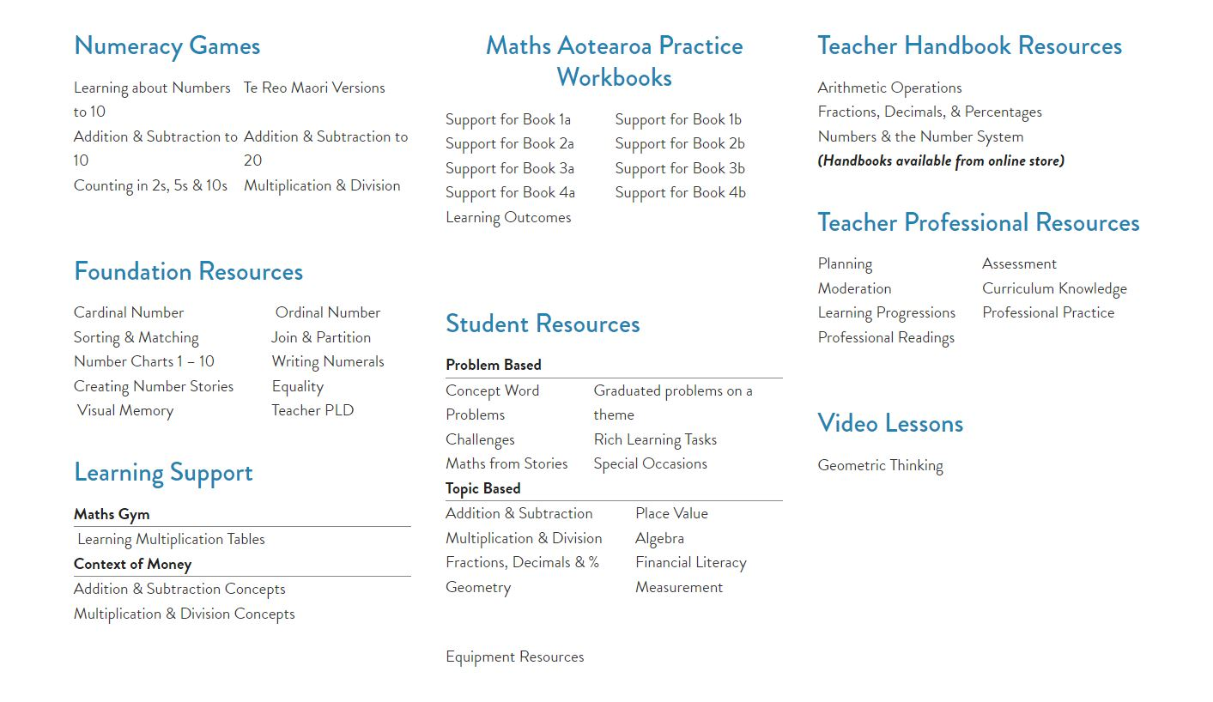
You can now explore all the wonderful resources that you now have to build and support a rich mathematics programme.

